Slide 1
Scale and Skill in Active Management Lubos Pastor Robert F. Stambaugh Lucian A. Taylor
Xijie Cheng
Topics in Quantitative Finance

Slide 2
Content
Introduction
Methodology
Data
Results
Conclusion
My opinion

Slide 3
Background
The performance of active funds has been of long-standing interest to financial economics.
Raw skill & Constraints: one popular discussion is Decreasing Returns to scale
skill & scale interact: to learn about skill, must know the effects of scale
Two hypotheses: Fund-level DRS & Industry-level DRS

Slide 4
Simple OLS
1. Simple OLS regression model:
(1)
$R_{it}:benchmark−adjusted return of fund i in period t$
$q_{it−1}:fund^{′}s size at the end ot period t−1$
Skill?
Omitted-variable bias!

Slide 5
Omitted-variable bias
If the correlation between skill and fund size is positive, so is the bias in estimator
If the correlation is negative, so is the bias
The bias = the effect of skill on performance * the slope of skill on fund size
Fund Fixed Effects

Slide 6
Fund Fixed Effects
2. Fixed Effect Model
(2)
$R_{it}:$ benchmark-adjusted return of fund i in period t
$q_{it−1}:$ fund’s size at the end of period t-1
$a_{i}:$ fund fixed effects that soak up any variation in performance due to cross-sectional differences in fund skill

Slide 7
Fund Fixed Effects
2. Fixed Effect Model
(2)
Take a look at ${\hat{β}}_{i}$
Biased due to the positive correlation between and
Intuitively, fund’s return , assets value & attract more, size
Suppose $a_{i}=β=0$, consider 2-period sample:
, future fund performance is expected to be better
, future fund performance is expected to be worse

Slide 8
Recursive demeaning
should be equivalent to
, where are equal to minus full-sample time-series means at the fund level
Thus

Slide 9
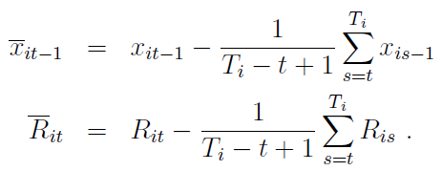
Recursive demeaning
Backward-demeaned by a mean computed using only fund i’s observations prior to t-1
Expand the FE model to include a vector of regressors $x_{it−1}$
Recursively backward-demeaned regressors ${\underline{x}}_{it−1}$for t = 2,…, Ti as
Recursively forward-demeaned regressors

Slide 10
Simulation exercise
1. Simple OLS Regression Model:
2. Fixed Effect Model：
3. Recursive Demeaning Model:

Slide 11
Simulation exercise

Slide 12
Simulation exercise - Results
Simple OLS estimates tend to be too high
OLS FE estimates tend to be too low
The RD estimators are quite close to the true value

Slide 13
Data
-
- FundSize equals the fund’s AUM at the end of the previous month, inflated to December 2011 dollars by using the ratio of the total market value of all CRSP stocks in December 2011
- market value of all stocks

Slide 14
Empirical results
1. Fund-level returns to scale
The biased OLS procedures indicate a negative relation between a fund’s size and its performance
The unbiased RD procedure produces negative point estimates, but unable to reject the null hypothesis
Modest in economic terms

Slide 15
Empirical results
2. Industry-level returns to scale
Strong negative relation between fund performance and industry size, both economically and statistically significant

Slide 16
Empirical results
2. Industry-level returns to scale
multiple regression
The slope on FundSize is negative and significant under OLS approach, but insignificant under the bias-free RD approach
The slope on IndustrySize is negative and significant

Slide 17
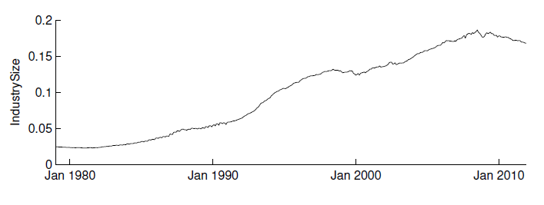
Empirical results
3. A closer look at industry size
Time trend?
Industry size:
Number of Funds
(a count of the sample funds)
Average Fund Size
(average AUM across all sample funds)

Slide 18
Empirical results
3. A closer look at industry size
OLS FE regression
Time trend
Number of Funds
Average Fund Size

Slide 19
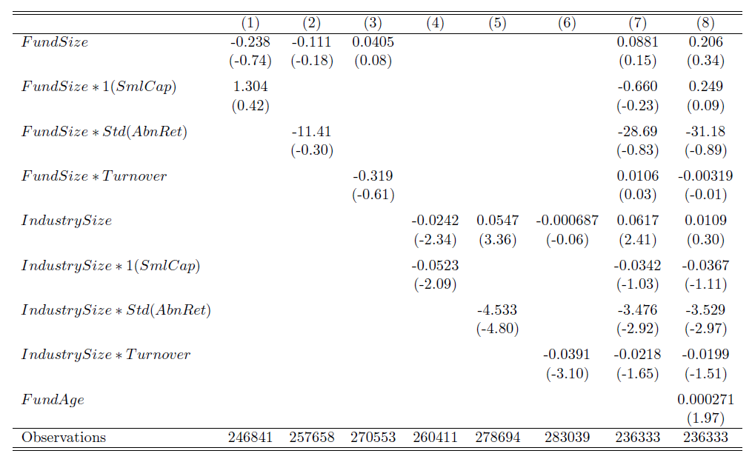
Empirical results
4. Size-performance relation
The negative relation between industry size and fund performance is stronger for funds that have high volatility and high turnover
The relation is also marginally stronger for small cap funds

Slide 20
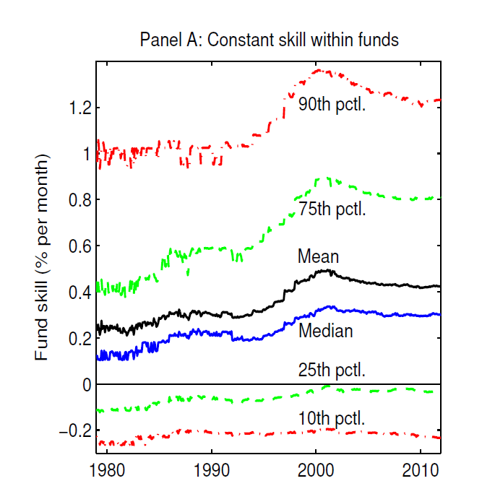
Empirical results
5. The evolution of fund skill
Funds have become more skilled over time, especially the above-average funds

Slide 21
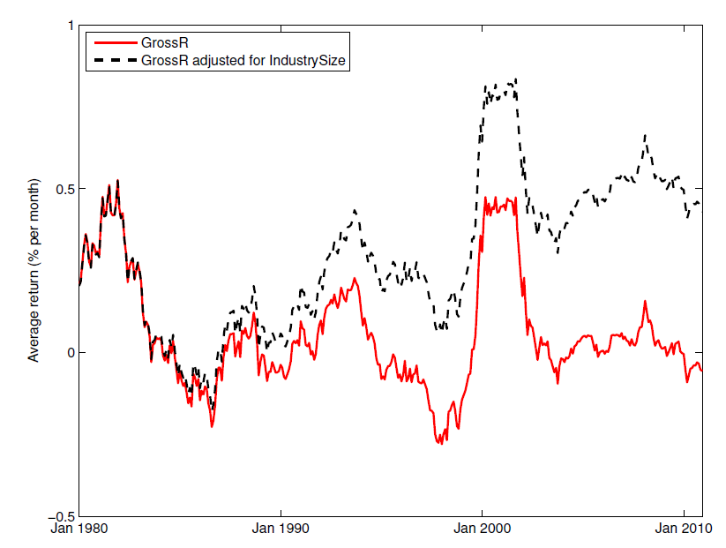
Empirical results
5. The evolution of fund skill
Funds have become more skilled over time, yet this improvement failed to boost fund performance

Slide 22
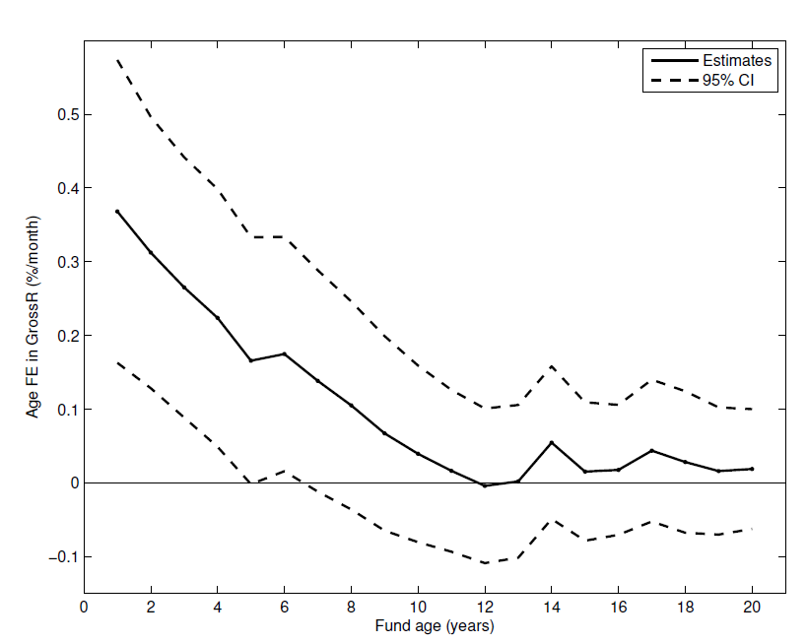
Empirical results
6. Performance Erosion over a fund’s lifetime
The figure plots fund age fixed effects in GrossR
Fund performance declines over a typical fund’s lifetime
Further support for this negative age-performance relation comes from a panel regression of GrossR on FundAge

Slide 23
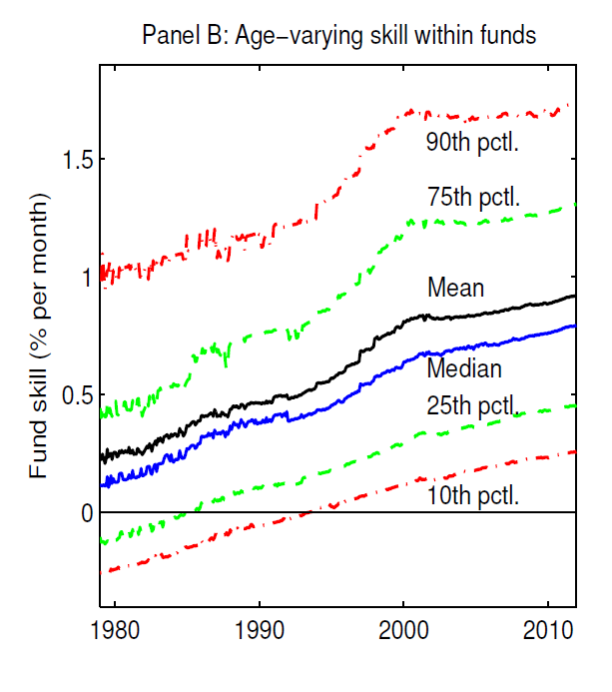
Empirical results
6. Performance Erosion over a fund’s lifetime

Slide 24
Empirical results
7. Age-based investment strategies
All six young-minus-old differences in gross returns are positive, and four of them are statistically significant.

Slide 25
Conclusions
Empirically analyze the interaction between skill and scale in active mutual fund management.
Identify 2 econometric biases at the fund level, while the alternative bias-free estimates point to DRS with insignificance statistically.
At the industry level, find strong evidence of DRS. This negative relation between industry and fund performance is stronger for funds with higher turnover and volatility as well as small-cap funds.
Active management industry has become more skilled over time, but the rise in skill failed to improve the average fund performance.
Young funds tend to outperform their older peers.
However, as funds grow older, their performance tends to deteriorate due to continued industry growth and the associated arrival of skilled competition.

Slide 26
Opinions
Provided a picture of empirical study, easy to follow, “ambitious”, how to make data talk
Fixed effects: assume skill of fund i is constant over time
The “separation” in the regression(multiple regressions) can result in Multi-Collinearity
Their explanation of the young beat the old: better educated and better acquainted with new technology

